Slide 1
ACGME
Avoiding Common Errors in the ADS Annual Update
Natalie moore
University of utah

Slide 2
DISCLOSURES
I AM NOT AN EXPERT
Notes:
Get your information from the source when it comes to RC and ACGME

Slide 3
Common Errors
Source: 2018 ACGME Conference:
  Program Directors not providing accurate
  and complete info
  Faculty Scholarly Activity
  Resident Scholarly Activity
  Block diagram
  Lack of documentation (as needed)
  Updating Faculty General Information

Slide 4
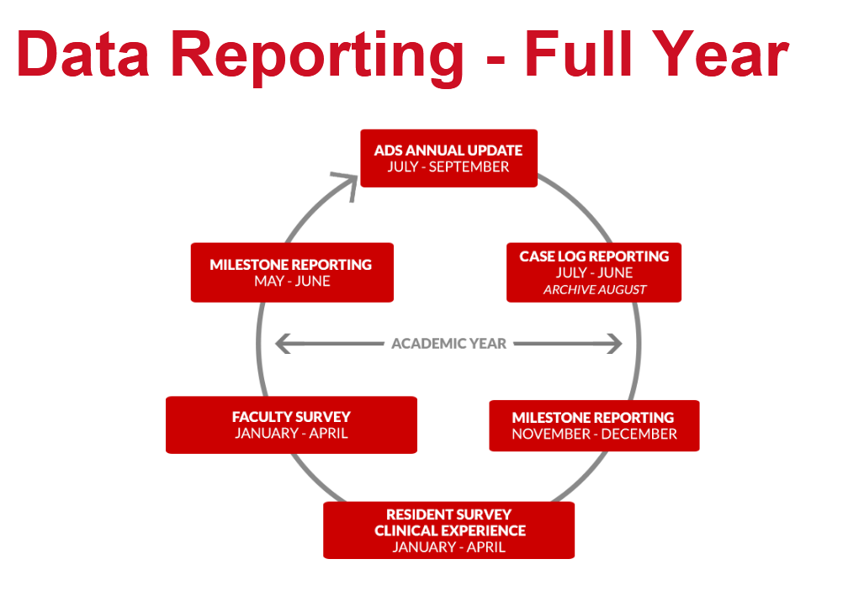
ADS Annual Update
  Fellowships (July-August)
  Residencies (August-September)

Slide 5
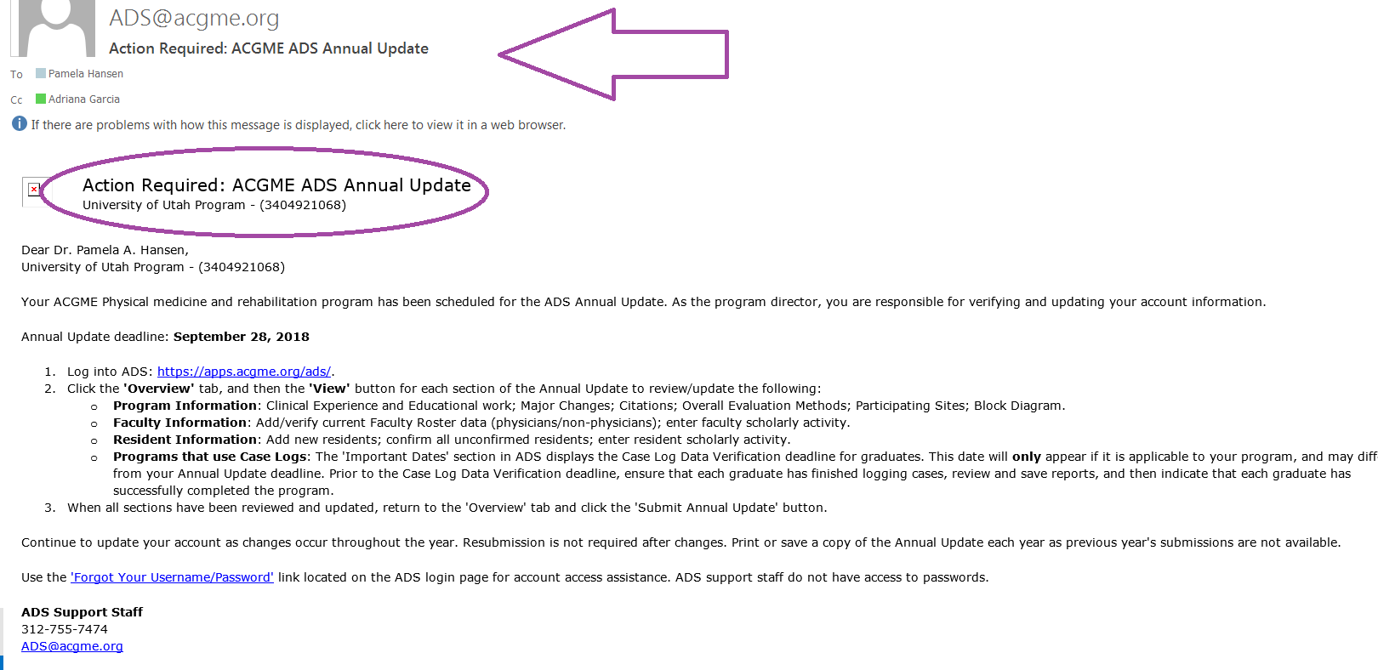
ACGME ADS Email to PD & PC

Slide 6


COMMUNICATION IS
  The Program Director and Program Coordinator should work collectively to manage the annual ADS.

Slide 7
REQUIRED DATA
  Program Info
  Work hours/Learning environment
  Responses to current citations
  Update major changes section
  Overall evaluation methods
  Participating sites

Slide 8
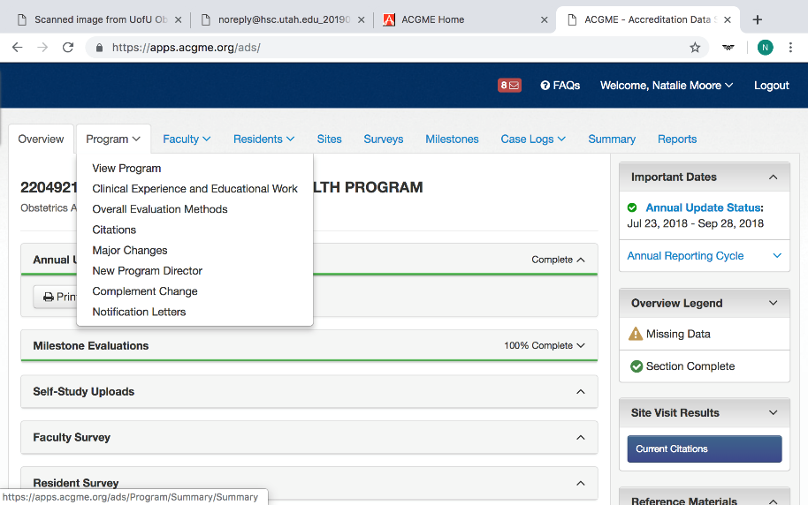

Slide 9
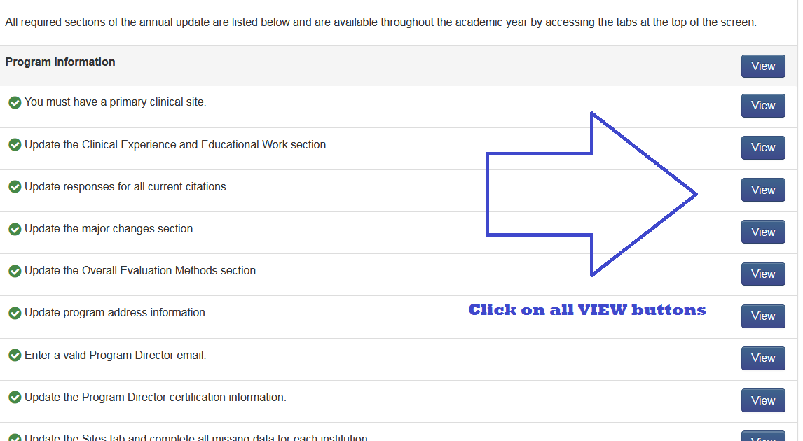
Review ALL of Your Program Information * VIEW ALL *
Sections with a yellow triangle
require attention

Slide 10
Review ALL of Your Program Information * VIEW ALL *
Sections with a green check are
complete and require no further attention

Slide 11

Review ALL of Your Program Information * VIEW ALL *
Always click ALL boxes and verify all info!
  Automatic Green - doesn’t mean it’s correct or up to date!

Slide 12
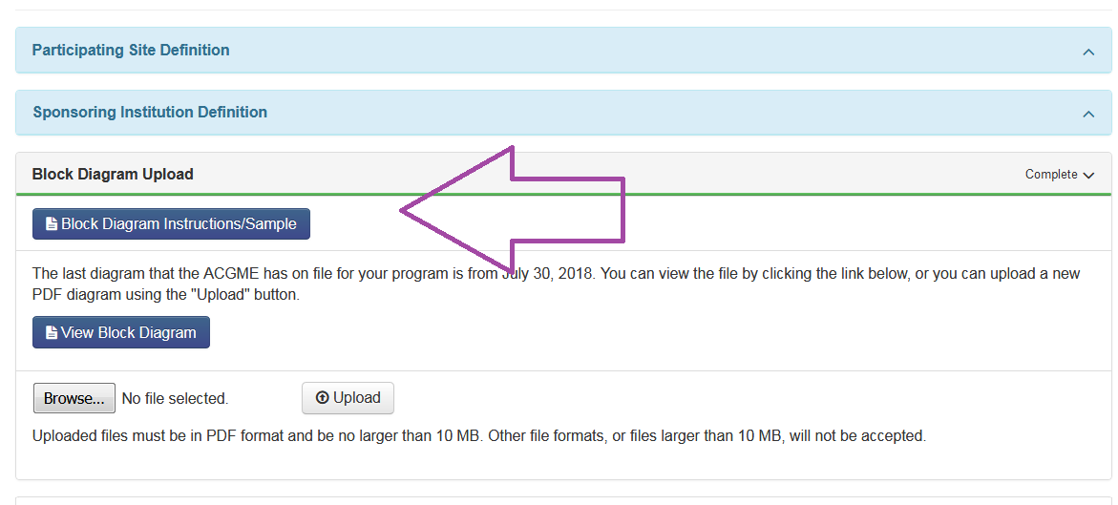
BLOCK DIAGRAM

Slide 13
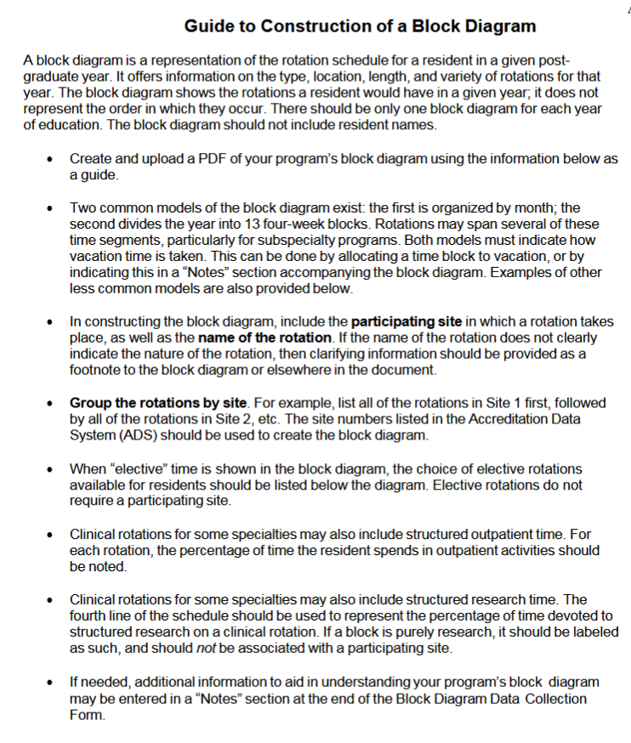
BLOCK DIAGRAM INSTRUCTIONS

Slide 14
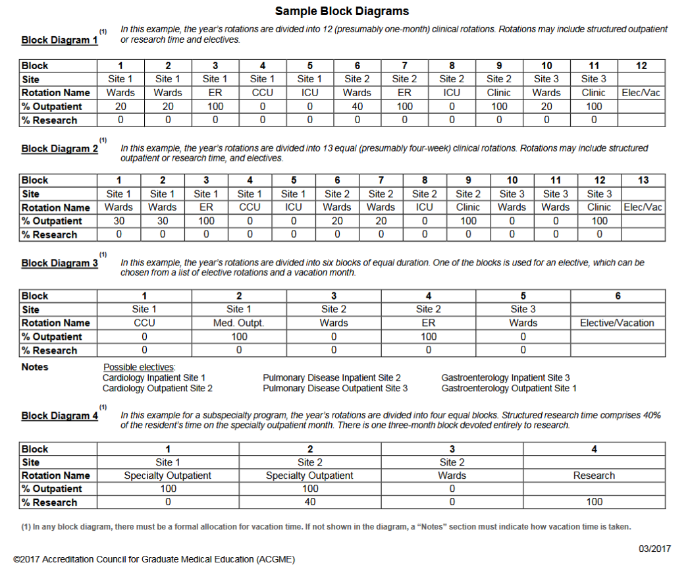
BLOCK DIAGRAM SAMPLES

Slide 15
COORDINATOR ROLE
Faculty Verification:
  Confirm faculty roster
  Add new faculty if needed
  Remove faculty if needed
  Review certification, hours, CV, and scholarly activity
Notes:
Remember – this can be updated ongoing

Slide 16
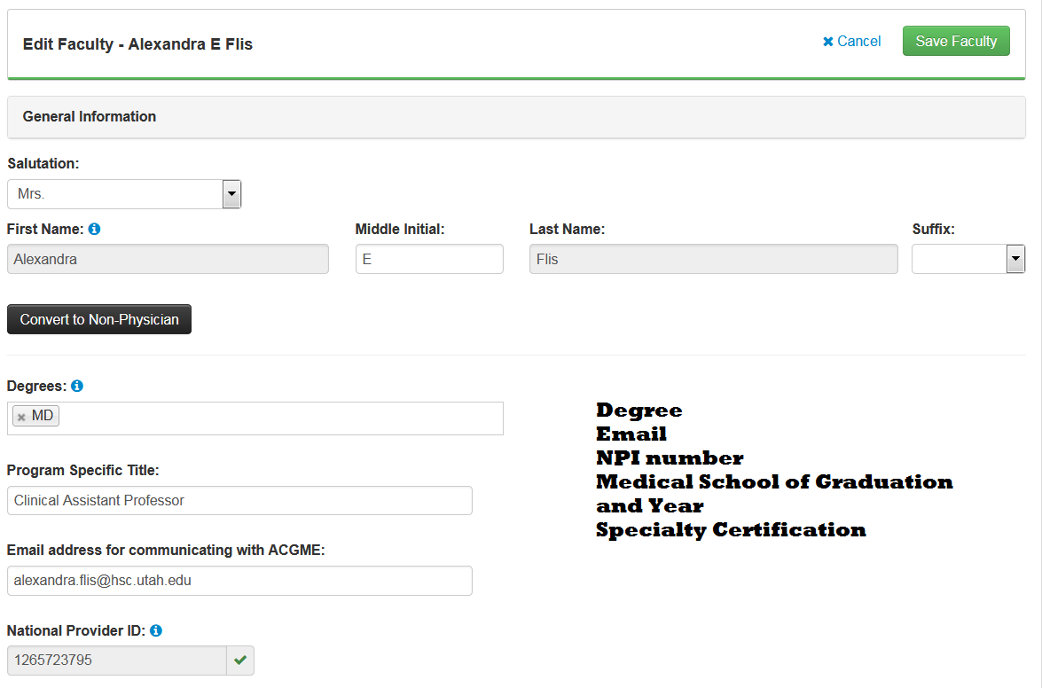
EDIT FACULTY MEMBER
Verify Personal Information

Slide 17
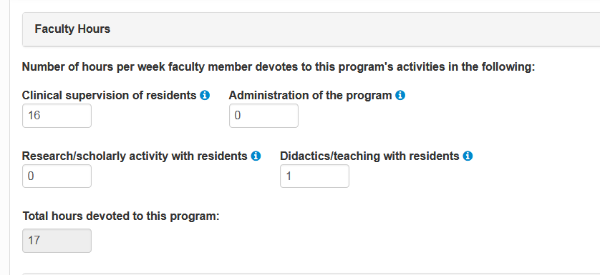
FACULTY HOURS

Slide 18
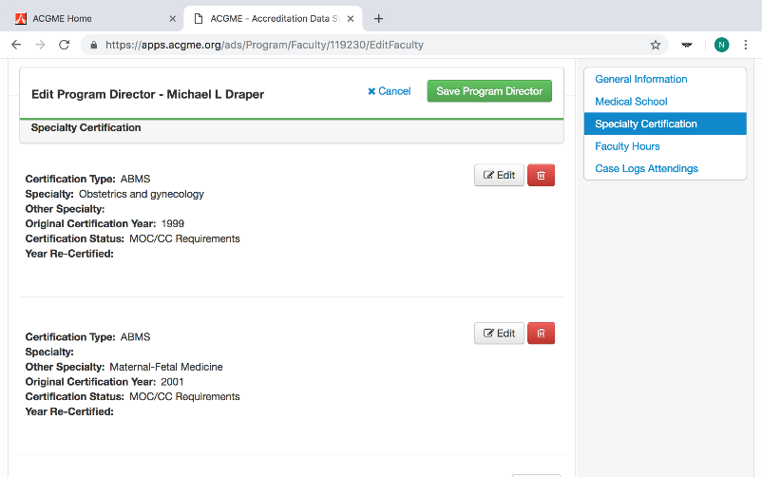
FACULTY CERTIFICATION

Slide 19
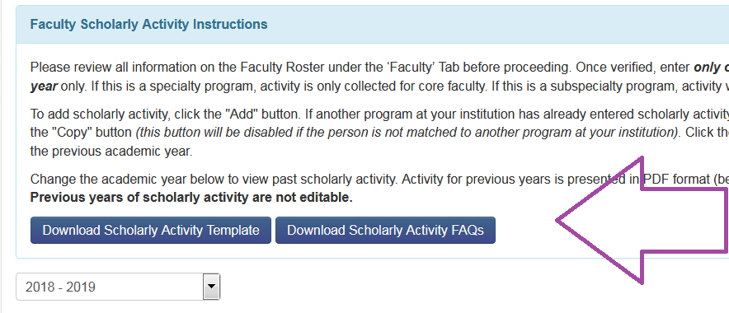
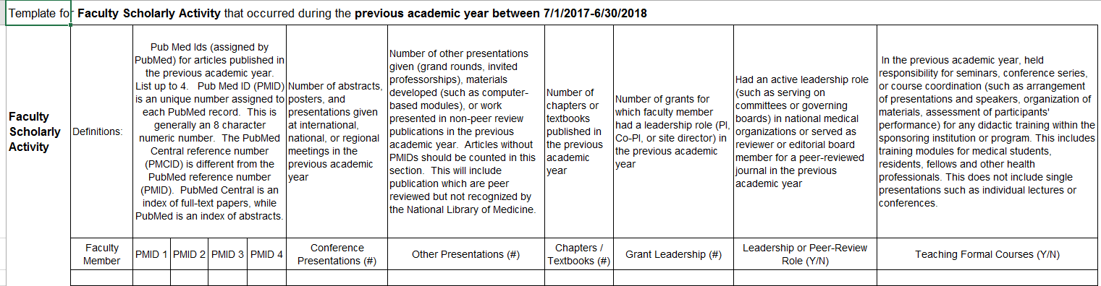
SCHOLARLY ACTIVITY

Slide 20
FACULTY SCHOLARLY ACTIVITY
Residency programs: only complete for
CORE physician faculty
Fellowship programs: complete for ALL physician faculty
  Everyone listed needs a response
  List activities that occurred during
  the previous year
  System will give error message when you
  try to re-use PMID for the same person

Slide 21
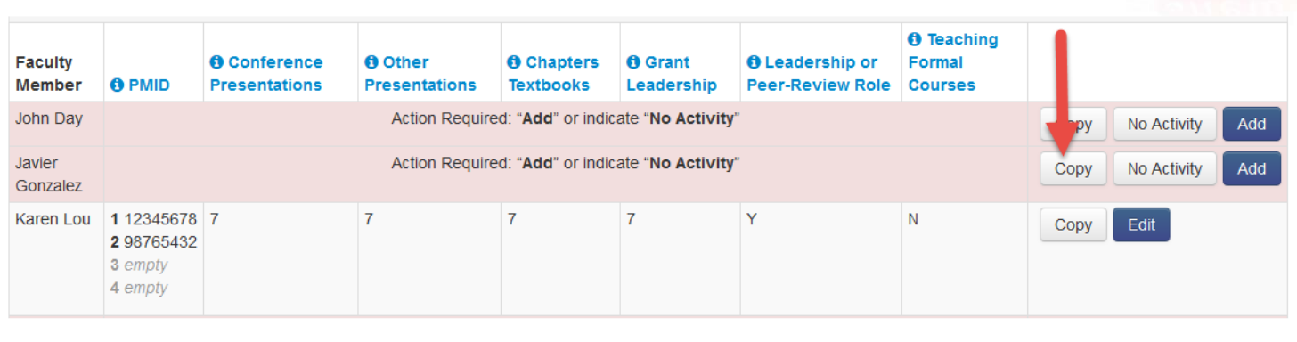
Faculty Scholarly Activity Copy Feature
* New *
Copy button will be enabled if the faculty is matched with the same faculty within the institution AND there are SA data that can be transferred.
Edits can be made after it is copied.

Slide 22
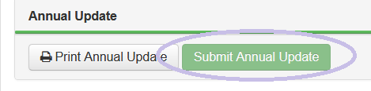
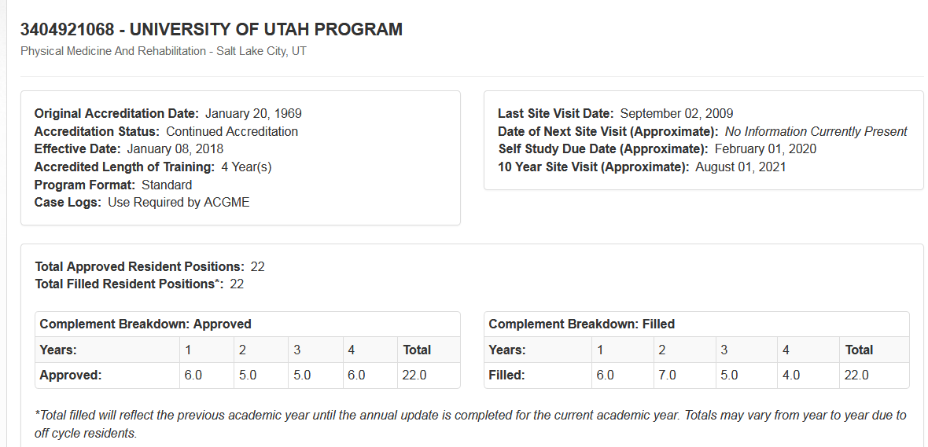
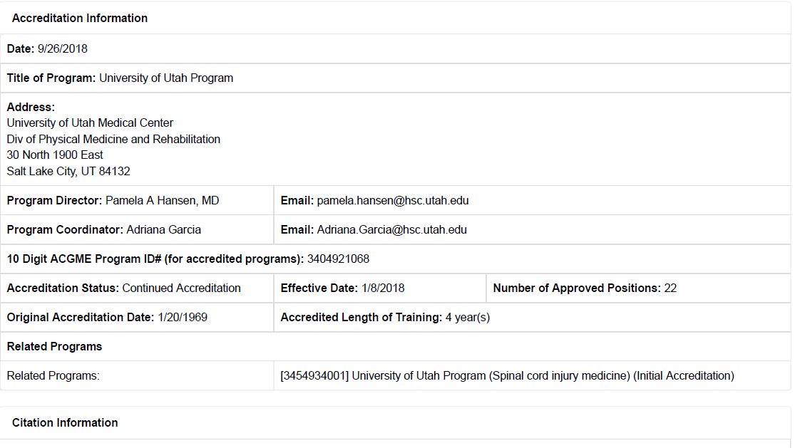
ACGME ADS Annual Update
Click - Submit Annual Update
Save a PDF copy from Reports
Review one more time
Online View
PDF View

Slide 23
ANNUAL UPDATE
It’s not just once a year
Update your information if you have any changes throughout the Academic Year
    Program
    Resident/Fellow
    Faculty

Slide 24
IN SUMMARY
ADS Deadlines are set by ACGME
Email your ACGME Specialty Team with questions
ADS is how you communicate to the RC
Communication between PD and PC is key
Print and save copy
Notes:
Deadline – give yourself a buffer

Slide 25
ACGME Resources
  Avoiding Common Errors in the ADS Annual Update Video Resources:
      Responding to Citations
      Entering Scholarly Activity into ADS
      Creating an Effective Block Schedule
      https://www.acgme.org/Program-Directors-and-Coordinators/Avoiding-Common-Errors-in-the-ADS-Annual-Update

