Slide 1
How to Be a Successful Program Manager Natalie Moore Associate Director of Education University of Utah

Slide 2
Program
Director
Residents
Program
Manager
CREOG
RRC ACGME
Faculty
The Program Manager is the Center of the Universe

Slide 3
ACGME Definition
The coordinator is the person with the most global view of the program, including (but not limited to):
Resident concerns
Approaching deadlines
Changes in RRC, CREOG and ABOG requirements
Institutional policies
Notes:
ACGME definition

Slide 4
Residency Training
Residency is an essential dimension of the transformation of the medical student to the independent practitioner along the continuum of medical education. It is physically, emotionally, and intellectually demanding, and requires longitudinally-concentrated effort on the part of the resident.
ACGME Program Requirements

Slide 5
My Definition
Mama bear
Nag
Friend
Leader
Problem Solver
Confidant
Therapist
Record Keeper
Party Planner
Housekeeper
Meal Planner
Babysitter
Fashion Consultant
Fortune Teller
Cat herder

Slide 6
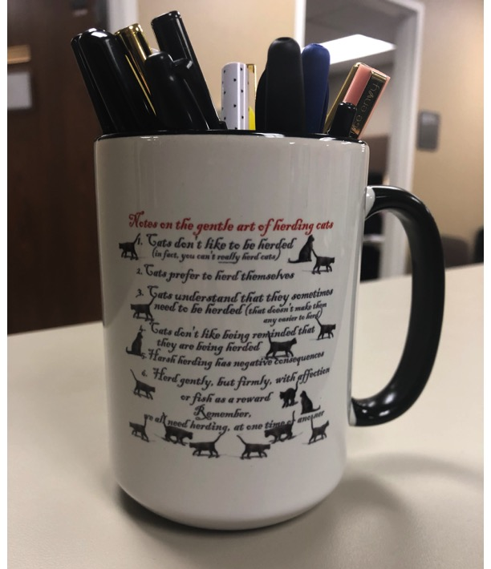
The Gentle Art of Herding Cats

Slide 7
My Keys for Success
Relationships
Leadership
Resiliency
Organization
Communication
Adaptability
Positivity

Slide 8
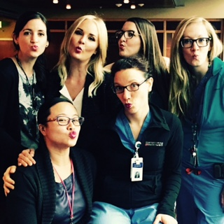
Relationships

Slide 9
Build Relationships on Respect
#1 Key for Success
Respect Residents
Respect Faculty
Respect the Process!
They will respect you

Slide 10
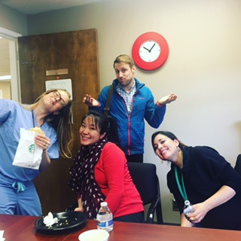
Leadership

Slide 11
Leadership
What kind of leader do you want to be?
Build engagement and accountability
What is the reality
What does GREAT look like right now
Benefit of the doubt
Ownership
Appreciation

Slide 12
Be Resilient
Words from my chairman:
“You need to be able to deal with a lot of crap and keep going.”

Slide 13
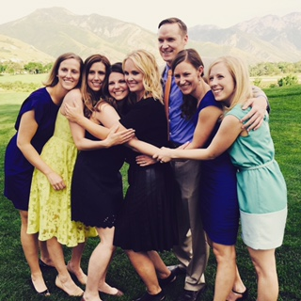
Your Own Wellness
Greatest job in the world!
It can be a career
Take care of
yourself
Find a safe zone
Enjoy it!

Slide 14
Organization
Be Organized!
Use APMOG Timeline
Always think 6 months ahead
Create your own checklist system
“Debrief” after each event

Slide 15
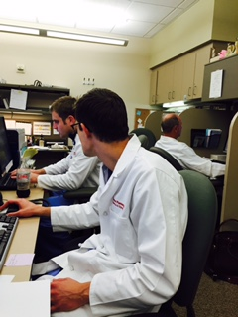
Communication
Communication is KEY!
Program Director
Residents
Faculty
You are a team!

Slide 16
Adapt to Change
Change happens all time
At the Resident level
At the Faculty level
At the Dept Administration level
At the Institutional Level
At the RRC – ACGME Levels
You will prepare, prepare and prepare more, only to think you are ready, then THINGS CHANGE !
MUST ADAPT
Notes:
The only thing you can control is how you react to change!

Slide 17
Positivity

Slide 18
Positivity
Be a Drama-free Zone
It takes effort
Be a good example
Don’t allow yourself to be manipulated

Slide 19
Tips for Success from Residents
Be an advocate for all parties
Realistic communication
Be available (open door policy)
Keep confidences
Care about us!

Slide 20
Tips for Success From Coordinators
It takes a year
Patience
Have a passion for it !
Love the residents like they are your own kids

Slide 21
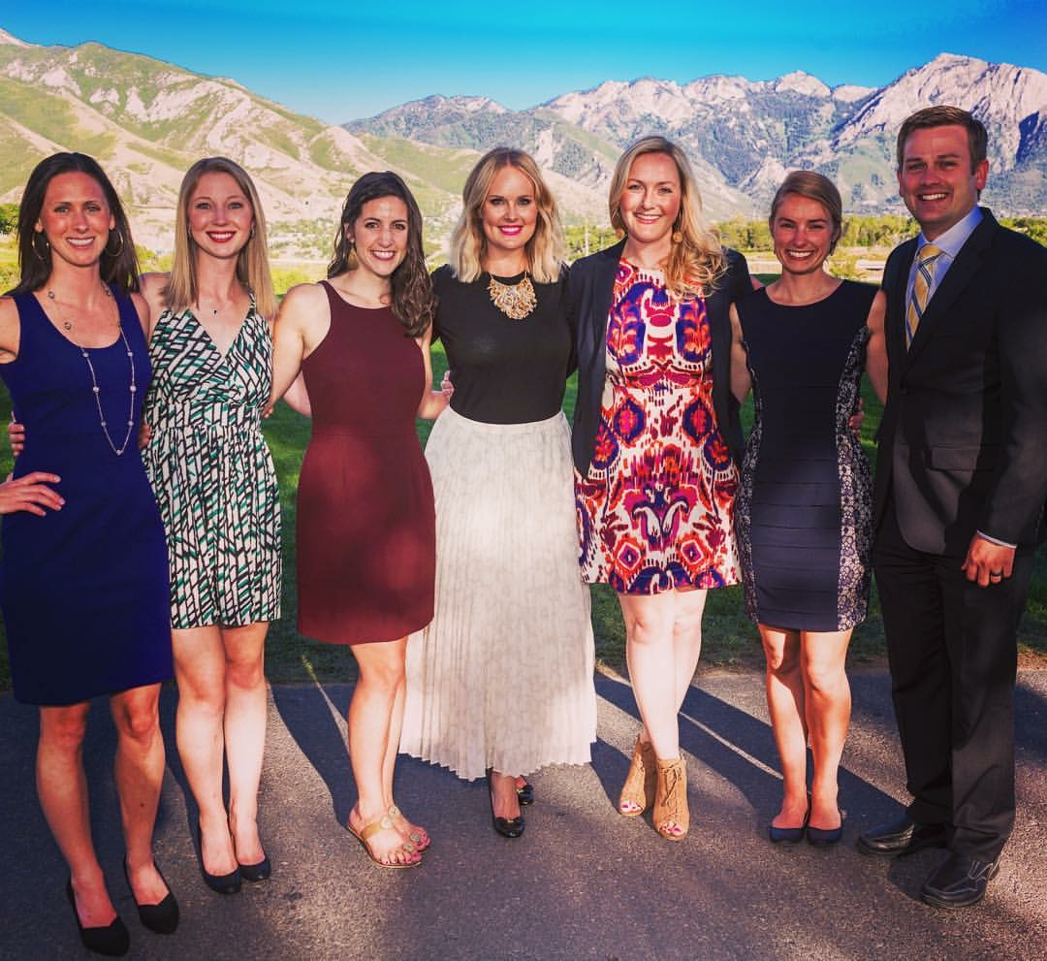

Slide 22
The ABCs of OBGYN
ACGME
PEC
ACOG
CCC
FLS
APMOG
ABOG
CREOG
RC
APGO
ADS
APE

Slide 23
The ABCs of OBGYN Training
CREOG
Council on Resident Education in Obstetrics and Gynecology
ACOG
American College of Obstetricians and Gynecologists
ABOG
American Board of Obstetrics and Gynecology

Slide 24
The ABCs of OBGYN Training
APGO
Association of Professors of Obstetrics and Gynecology
APMOG
Association of Program Managers in Obstetrics and Gynecology

Slide 25
The ABCs of OBGYN Training
ACGME
American College of Graduate Medical Education
ADS
Accreditation Data System
RC or RRC
Review Committee (fka Resident Review Committee)

Slide 26
The ABCs of OBGYN Training
PEC
Program Evaluation Committee
CCC
Clinical Competency Committee
FLS
Fundamentals of Laparoscopic Surgery
APE
Annual Program Evaluation

Slide 27
The ABCs of OBGYN Training
“The Board” = ABOG
Written Exam = Qualifying Exam
Oral Exam = Certifying Exam
“The College” = ACOG
CREOG = exam, meeting and organization

Slide 28
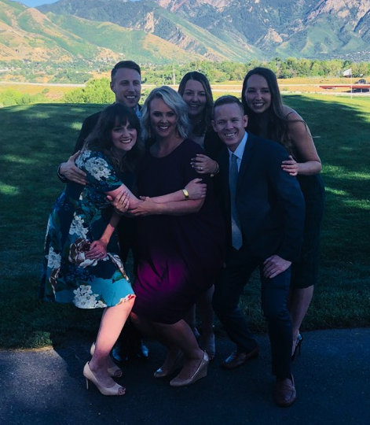
In the end… Enjoy it!

